Slide 1
Cluster-Reduce: Compressing Sketches
for Distributed Data Streams
KDD’21, August 14–18, 2021, Virtual Event, Singapore.
Yikai Zhao∗, Zheng Zhong∗, Yuanpeng Li∗, Yi Zhou∗, Yifan Zhu∗,
Li Chen‡, Yi Wang§, Tong Yang∗
∗Peking University, China; ‡HUAWEI, China; §Southern University of Science and Technology, China
Notes:
Hello everyone, I’m Yikai Zhao from Peking University. I’m going to introduce Cluster-Reduce: Compressing Sketches for Distributed Data Streams.

Slide 2
01
Part One
Background
Notes:
Let’s start with the background of the sketch, and some existing work.

Slide 3
Count-Min Sketch
Data Structure:
a counter array $A$ with width $w$.
$d$ hash functions $h_{1}\left(⋅\right),⋯,h_{d}\left(⋅\right)$，each of which maps an item $e$ to a counter.
Insert: $A\left[h_{i}\left(e\right)\right]+=1, ∀ i=1,⋯,d$
Query: $\min\left[h_{1}\left(e\right),⋯,h_{d}\left(e\right)\right]$
C
C
B
A
C
C
B
A
 |  | 2 |  | 2 |  | 1 |  | 1 | 2 |  |  | 3 |  | 1
CM sketch with $w=16, d=3$
Notes:
Sketch is a probabilistic data structure for processing and analyzing data stream with large volume and high velocity.
The Count-Min sketch, or the CM sketch for short, is one of the most widely used sketches. Let me briefly introduce the CM sketch first.
As shown in the figure, a CM sketch contains an array of counters, and in this case, the width is 16. A CM sketch is also associated with several independent hash functions, each of which can map an item to a counter uniformly and randomly.
The CM sketch is widely used to count the frequency of each item in the data stream.

Slide 4
Count-Min Sketch
Data Structure:
a counter array $A$ with width $w$.
$d$ hash functions $h_{1}\left(⋅\right),⋯,h_{d}\left(⋅\right)$，each of which maps an item $e$ to a counter.
Insert: $A\left[h_{i}\left(e\right)\right]+=1, ∀ i=1,⋯,d$
Query: $\min\left[h_{1}\left(e\right),⋯,h_{d}\left(e\right)\right]$
C
C
B
A
C
C
B
A
 |  | 3 |  | 2 |  | 1 |  | 2 | 2 |  |  | 3 |  | 2
CM sketch with $w=16, d=3$
Notes:
To insert an incoming item, the CM sketch first uses hash functions to locate several counters, and increases each of these counters by one. The slide shows the process of inserting four items A, B, C, and C into the CM sketch.

Slide 5
Count-Min Sketch
Data Structure:
a counter array $A$ with width $w$.
$d$ hash functions $h_{1}\left(⋅\right),⋯,h_{d}\left(⋅\right)$，each of which maps an item $e$ to a counter.
Insert: $A\left[h_{i}\left(e\right)\right]+=1, ∀ i=1,⋯,d$
Query: $\min\left[h_{1}\left(e\right),⋯,h_{d}\left(e\right)\right]$
C
C
B
A
C
C
B
A
 |  | 4 |  | 2 |  | 2 |  | 2 | 2 |  |  | 4 |  | 2
CM sketch with $w=16, d=3$
Notes:
To insert an incoming item, the CM sketch first uses hash functions to locate several counters, and increases each of these counters by one. The slide shows the process of inserting four items A, B, C, and C into the CM sketch.

Slide 6
Count-Min Sketch
Data Structure:
a counter array $A$ with width $w$.
$d$ hash functions $h_{1}\left(⋅\right),⋯,h_{d}\left(⋅\right)$，each of which maps an item $e$ to a counter.
Insert: $A\left[h_{i}\left(e\right)\right]+=1, ∀ i=1,⋯,d$
Query: $\min\left[h_{1}\left(e\right),⋯,h_{d}\left(e\right)\right]$
C
C
B
A
C
C
B
A
 |  | 4 |  | 3 |  | 2 |  | 2 | 3 |  |  | 5 |  | 2
CM sketch with $w=16, d=3$
Notes:
To insert an incoming item, the CM sketch first uses hash functions to locate several counters, and increases each of these counters by one. The slide shows the process of inserting four items A, B, C, and C into the CM sketch.

Slide 7
Count-Min Sketch
Data Structure:
a counter array $A$ with width $w$.
$d$ hash functions $h_{1}\left(⋅\right),⋯,h_{d}\left(⋅\right)$，each of which maps an item $e$ to a counter.
Insert: $A\left[h_{i}\left(e\right)\right]+=1, ∀ i=1,⋯,d$
Query: $\min\left[h_{1}\left(e\right),⋯,h_{d}\left(e\right)\right]$
C
C
B
A
C
C
B
A
 |  | 4 |  | 4 |  | 2 |  | 2 | 4 |  |  | 6 |  | 2
CM sketch with $w=16, d=3$
Notes:
To estimate the frequency of an item, such as C, the CM sketch will return the minimum value of all hashed counters. In this case, the frequency of item C is estimated to be the minimum value of 4, 4, and 6, that is, 4.

Slide 8
Various Sketches
Counting Tasks
Frequency
Frequency distribution
Cardinality
Entropy
…
KV Tasks
Frequent item
Persistent item
…
…
CU sketch
CM
sketch
Count sketch
MaxLog
Hash
Sketches
Elastic
sketch
ADA-SKETCH
Heavy
Guardian
Waving
Sketch
Notes:
Sketches can be used to perform a variety of tasks. The most basic tasks can be divided into to two categories, counting tasks and KV tasks.
Counting tasks include estimating the frequency of each item in the data stream, estimating the cardinality, entropy, and frequency distribution of the whole data stream, and so on;
KV tasks include finding the most frequent items, the most persistent items, and so on.
In recent years, the data structure of sketch has been paid more and more attention by researchers. In addition to the CM sketch, a variety of sketches have been proposed, such as the CU sketch, the Count sketch, the Elastic sketch, and so on. These sketches focus on different aspects of data stream processing and analysis, but they basically have similar data structure.

Slide 9
Distributed Tasks
Geo-distributed data analytics
Memory：GB
Bandwidth：Mbps
Sketch Compression
sketch
sketch
sketch
sketch
sketch
sketch
sketch
sketch
sketch
Notes:
With the rapid growth of data stream volume, data streams processing may be scattered on multiple devices globally. Geo-distributed data analytics is to estimate the item statistics or find frequent items in geo-distributed data streams using the sketches of CM, CU, or Count. In this scenario, we need to deploy sketches on various devices to process geo-distributed data streams, and we need to transmit the sketches across the network to a central analyzer, which performs the data mining task with a global review.
However, this is difficult for geographically distributed devices, as Internet bandwidth can be both limited and unreliable—it is at least one order of magnitude smaller than the local memory, thus becomes a bottleneck.
An efficient way is to compress the sketches, which can not only save bandwidth, but also make efficient use of memory and computation resources.

Slide 10
Distributed Tasks
Distributed machine learning
transmitting gradients $>$ computing gradients
Sketch Compression
sketch
sketch
sketch
sketch
sketch
Notes:
Distributed machine learning tasks use sketches to compactly represent the gradients on distributed machine learning devices. For distributed machine learning using parameter servers, transmitting gradients often takes more time than computing gradients, and becomes the bottleneck of distributed training. To reduce bandwidth usage, researchers use sketches to compactly represent gradients.
In addition, sketch compression techniques can be employed to further save bandwidth and improve training efficiency.
In summary, for the above two use-cases and more scenarios where bandwidth efficiency is crucial, sketch compression is necessary and desirable.

Slide 11
Sketch Compression
Efficiency
Direct Query
decompressing all the collected sketches in the central analyzer or parameter server is time-consuming.
storing all decompressed sketches is memory-consuming.
Accuracy
Decompress
Direct Query
Notes:
We summarize the design goals of sketch compression mechanism as follows:
Efficiency: In data mining, the value of data decreases rapidly with time passing, the compression speed of sketches must be fast. For distributed machine learning, speed is also desirable as a slow compression algorithm prolongs the model training.
Direct Query: We desire that the compressed sketch can be queried directly without decompression, which cannot be supported by traditional compression algorithms (e.g., Huffman coding). This goal is necessitated by two factors: 1) decompressing all the collected sketches in the central analyzer or parameter server is time-consuming; 2) storing all decompressed sketches is memory-consuming.
Accuracy: For direct queries on the compressed sketch, the results should be accurate. Inaccurate query results may cause intolerable disruption to data mining and machine learning.

Slide 12
Related Work
Hokusai
38 | 8 | 5 | 9 | 23 | 2 | 42 | 8 | 5 | 2 | 39 | 16 | 14 | 9 | 9 | 21
Notes:
Most existing works focus on compressing the CM sketch.

Slide 13
Related Work
Hokusai
38 | 8 | 5 | 9 | 23 | 2 | 42 | 8 | 5 | 2 | 39 | 16 | 14 | 9 | 9 | 21
$$38+8$$
$$5+9$$
$$23+2$$
$$42+8$$
$$5+2$$
$$39+16$$
$$14+9$$
$$9+21$$
46 | 14 | 25 | 50 | 7 | 55 | 23 | 30
Notes:
Hokusai is the first to compress the CM sketch. It adds up every two adjacent counters in a CM sketch to halve its memory consumption. And the compressed sketch still guarantees one-side error. In fact, the compressed sketch is exactly the same as building a half size sketch.

Slide 14
Related Work
Elastic sketch
38 | 8 | 5 | 9 | 23 | 2 | 42 | 8 | 5 | 2 | 39 | 16 | 14 | 9 | 9 | 21
$$\max\left(38,8,5,9\right)$$
$$\max\left(23,2,42,8\right)$$
$$\max\left(5,2,39,16\right)$$
$$\max\left(14,9,9,21\right)$$
38 | 42 | 39 | 21
Notes:
An improved work, the Elastic sketch, first divides the counter array, and adjacent counters are divided into one group. Then Elastic uses the maximum value of the counters in each group instead of the sum to build the compressed sketch, improving the accuracy.

Slide 15
Related Work
adjacent counters are independent and skewed, often have great differences
Notes:
These works achieve the first two design goals. But they are both inaccurate, because they ignore the relative difference in counters’ values. A sketch is a stochastic encoding of item statistics (e.g., frequency), and adjacent counters are independent and skewed, often have great differences.

Slide 16
02
Part Two
Algorithm
Notes:
Next, we introduce our algorithm, Cluster-Reduce.

Slide 17
Cluster-Reduce
Nearness Clustering
rearrange the chaotic counters in nearby groups into clusters.
Original Sketch
27 | 19 | 11 | 9 | 8 | 29 | 3 | 7 | 72 | 42 | 69 | 37 | 13 | 17 | 91 | 3
$$𝒢_{2}$$
$$𝒢_{2}$$
$$𝒢_{3}$$
$$𝒢_{3}$$
$$𝒢_{4}$$
$$𝒢_{1}$$
$$𝒢_{4}$$
$$𝒢_{1}$$
$$𝒞_{1}$$
$$𝒞_{2}$$
$$𝒞_{3}$$
$$𝒞_{4}$$
$$𝒞_{5}$$
Clusters
Notes:
Cluster-Reduce has two steps. The first step is named nearness clustering, which is the key technique of Cluster-Reduce. Same as Elastic, counters are divided into groups based on adjacency. In this step, we rearrange the chaotic counters in nearby groups into clusters. Afterwards, the values of counters in each clusters should be similar.
Nearness clustering is our key technique to achieve accuracy, and we explain its rationale as follows: The counters in each group are often skewed and chaotic. If we use the sum or the maximum value to represent all counters in a group, the largest counter will significantly increase all the small counters, and cause large overestimation errors to these counters. By classifying counters with similar values in nearby groups into a cluster, using the maximum value as the representative will only cause a slight over-estimation error to each counter.
Note that nearness clustering only allows the counters in near groups to be classified into a cluster, so as to reduce the overhead of time and space during the clustering process. In the example shown in the slide, each counter can only be classified into clusters on the left or right.

Slide 18
Cluster-Reduce
Unique Reducing
reduces each cluster to a unique representative value.
Original Sketch
27 | 19 | 11 | 9 | 8 | 29 | 3 | 7 | 72 | 42 | 69 | 37 | 13 | 17 | 91 | 3
$$𝒢_{1}$$
$$𝒢_{2}$$
$$𝒢_{3}$$
$$𝒢_{4}$$
$$𝒞_{1}$$
$$𝒞_{2}$$
$$𝒞_{3}$$
$$𝒞_{4}$$
$$𝒞_{5}$$
Clusters
maximum
maximum
maximum
maximum
27
11
42
91
17
Representatives
Notes:
The second step is named unique reducing, which reduces each cluster to a unique representative value. For each cluster, we traverse all counters in it and elect the maximum value as the representative of the cluster. Then we get a representative array.

Slide 19
Cluster-Reduce
Clustered / Compressed Sketch
Original Sketch
27 | 19 | 11 | 9 | 8 | 29 | 3 | 7 | 72 | 42 | 69 | 37 | 13 | 17 | 91 | 3
$$𝒢_{1}$$
$$𝒢_{2}$$
$$𝒢_{3}$$
$$𝒢_{4}$$
27
11
42
91
17
Representatives
0 | 0 | 1 | 1 | 0 | 1 | 0 | 0 | 1 | 0 | 1 | 0 | 1 | 1 | 0 | 1
Indicator Array
Notes:
We use a 1-bit indicator for each counter to record the cluster it belongs to: 0 indicates left and 1 indicates right. After the above two steps, we compress the CM sketch into a representative array and an indicator array.

Slide 20
Cluster-Reduce
Clustered / Compressed Sketch
$\min\left(8,7,13\right)=7$
Original Sketch
$$h_{1}=4$$
$$h_{2}=7$$
$$h_{3}=12$$
27 | 19 | 11 | 9 | 8 | 29 | 3 | 7 | 72 | 42 | 69 | 37 | 13 | 17 | 91 | 3
$$𝒢_{1}$$
$$𝒢_{2}$$
$$𝒢_{3}$$
$$𝒢_{4}$$
27
11
42
91
17
Representatives
0 | 0 | 1 | 1 | 0 | 1 | 0 | 0 | 1 | 0 | 1 | 0 | 1 | 1 | 0 | 1
Indicator Array
Notes:
Next, we use an example to show how to query directly in the compressed sketch. To query the frequency of an item, we first need to locate several hashed counters. In this case, they are the 5th, 8th, and 13th counters.
When querying in the original sketch, we directly use the minimum value 7 of the three counters as the frequency estimation.

Slide 21
Cluster-Reduce
Clustered / Compressed Sketch
$\min\left(11,11,17\right)=11$
Original Sketch
$$h_{1}=4$$
$$h_{2}=7$$
$$h_{3}=12$$
27 | 19 | 11 | 9 | 8 | 29 | 3 | 7 | 72 | 42 | 69 | 37 | 13 | 17 | 91 | 3
$$𝒢_{1}$$
$$𝒢_{2}$$
$$𝒢_{3}$$
$$𝒢_{4}$$
27
11
42
91
17
Representatives
0 | 0 | 1 | 1 | 0 | 1 | 0 | 0 | 1 | 0 | 1 | 0 | 1 | 1 | 0 | 1
Indicator Array
Notes:
When querying in the compressed sketch, we first use the same hash functions to locate three indicators, and learn that the three counters are classified into the 2nd, 2nd, and 5th clusters respectively. Therefore, we use the minimum of the representative values of the three clusters as the estimated frequency of this item, that is, 11.
It also shows that compressing a sketch brings some error to frequency estimation, but it worth noting that this is much more accurate than building a small sketch directly.

Slide 22
Dynamic Programming
Neighbour Clustering using 1-bit Indicator
Let $O_{k}\left[S_{k}\right]$ be the optimal classification strategy for the first $k$ groups when the strategy for the group $G_{k}$ is $S_{k}$
By enumerating all $2^{λ}$ strategies $S_{k−1}$ for the group $G_{k−1}$, we can obtain $O_{k}\left[S_{k}\right]$ inherited from one of $O_{k−1}\left[S_{k−1}\right]$.
$$S_{k−1}=\left\{1, 0, 0, 1\right\}$$
$$S_{k}=\left\{0, 1, 0, 1\right\}$$
$$S_{k+1}=\left\{0, 1, 1, 1\right\}$$
$$𝒞_{k−1}$$
✅
$$𝒞_{k}$$
❓
$$𝒞_{k+1}$$
$$𝒞_{k+2}$$
❓
✅
✅
❓
Notes:
Now we introduce how to find an optimal classification scheme when using one bit indicator. We propose a dynamic programming method to classify counters for minimizing the compression error, that is, the difference between the counters in the original sketch and the representatives of their clusters.
Specifically, let Sk be the classification strategy for counters in the group k. Let Ok[Sk] be the optimal classification strategy for the first k groups when the strategy for the group k is Sk . By enumerating all strategies Sk-1 for the group k-1 , we can obtain Ok[Sk] inherited from one of Ok-1[Sk-1].

Slide 23
Iterative Clustering
Region Clustering using Multi-bit Indicator
1 | 1000 | 10 | 100 | 10 | 100
Case 1
1
10 | 10 | 100 | 100 | 1000
❌
Case 2
1 | 10 | 10
100 | 100 | 1000
❌
Case 3
1 | 10 | 10 | 100 | 100
1000
❌
Case 4
1
10 | 10
100 | 100
1000
✅
Notes:
Using one-bit indicators is simple, but not flexible enough. For example, given 6 counters in a group are 1, 1000, 10, 100, 10, and 100, each counter has only 2 candidate clusters using one-bit indicators. Unfortunately, classifying them into two clusters will cause a very large error. To address this issue, we propose to use multi-bit indicators, empowering Cluster-Reduce much more flexibility to find better classification strategies.
When using multi-bit indicators, the number of classification strategies for each group increases exponentially, and the time complexity of dynamic programming increases even faster. Therefore, it is necessary to design a more efficient method to obtain a classification strategy, although it may be not so accurate as dynamic programming .

Slide 24
Iterative Clustering
Region Clustering using Multi-bit Indicator
The optimal classification strategy is actually a local, one-dimensional clustering of integers.
K-means
$$Iteration=0, error=424$$
28 | 64 | 40 | 76 | 46 | 7 | 16 | 50 | 39 | 30 | 37 | 27 | 9 | 83 | 5 | 19
0 | 0 | 0 | 0 | 3 | 0 | 0 | 3 | 1 | 0 | 3 | 2 | 1 | 2 | 3 | 0
76
30
39
83
37
Notes:
We find that the optimal classification strategy is actually a local, one-dimensional clustering of integers. Therefore, we extend K-means, one of the most widely used low-dimensional clustering methods, to an iterative clustering algorithm which can be used in the nearness clustering step of Cluster-Reduce.
Iterative clustering consists of multiple iterations, and each iteration has two steps. In the first step, each counter is classified into one of nearby clusters with the closest representative, which can be classified randomly in the first iteration. In the second step, each cluster uses the maximum of all the counters classified into it as its representative.

Slide 25
Iterative Clustering
Region Clustering using Multi-bit Indicator
The optimal classification strategy is actually a local, one-dimensional clustering of integers.
K-means
$$Iteration=1, error=136$$
28 | 64 | 40 | 76 | 46 | 7 | 16 | 50 | 39 | 30 | 37 | 27 | 9 | 83 | 5 | 19
1 | 0 | 2 | 0 | 2 | 1 | 1 | 2 | 1 | 0 | 3 | 0 | 0 | 2 | 0 | 0
76
30
50
83
37

Slide 26
Iterative Clustering
Region Clustering using Multi-bit Indicator
The optimal classification strategy is actually a local, one-dimensional clustering of integers.
K-means
$$Iteration=2, error=127$$
28 | 64 | 40 | 76 | 46 | 7 | 16 | 50 | 39 | 30 | 37 | 27 | 9 | 83 | 5 | 19
1 | 0 | 2 | 0 | 2 | 1 | 1 | 2 | 3 | 0 | 3 | 0 | 0 | 2 | 0 | 0
76
30
50
83
39
Notes:
In the example shown in the slide, iterative clustering converges after only three iterations.

Slide 27
Cluster-Reduce
COMPRESSING OTHER SKETCHES
CU Sketch
Count Sketch
MinMaxSketch
APPLICATIONS
Distributed Data Streams
Exact Key Frequency Estimation
Partial Key Frequency Estimation
Distributed Machine Learning
SketchML
Notes:
In addition to the CM sketch, our Cluster-Reduce can also be used to compress many other sketches. In the paper, we take the CU sketch, the Count sketch, and the MinMaxSketch as case studies.
We also apply our Cluster-Reduce to several distributed tasks, including two distributed frequency estimation tasks, and one distributed machine learning gradient transmission task.

Slide 28
03
Part Three
Experiments
Notes:
Next, we show some of the selected experimental results.

Slide 29
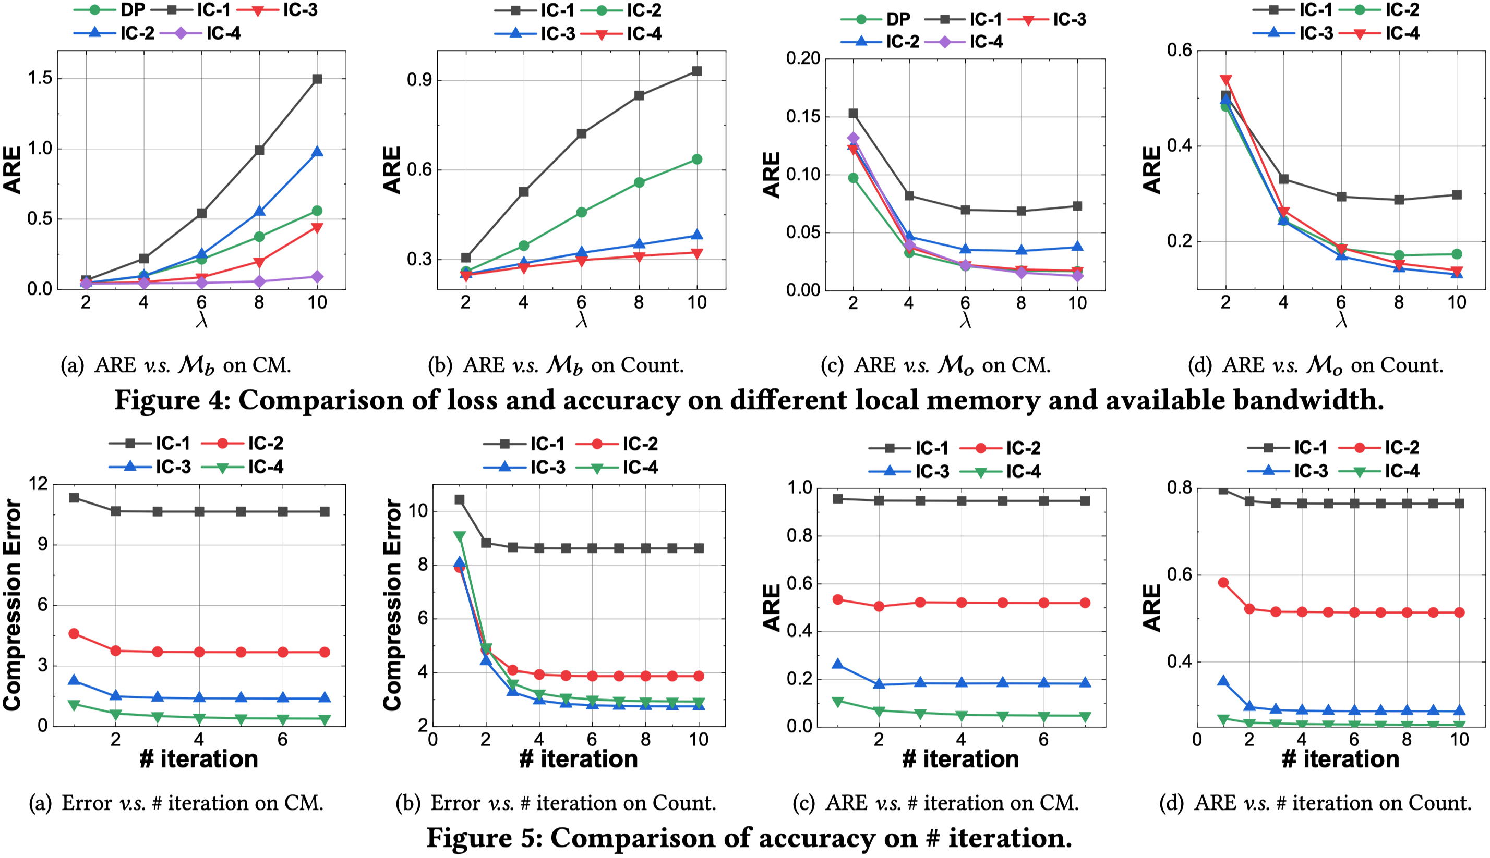
Experiments on Parameter Settings
Notes:
The first part is about parameter setting. The first four figures show that for the CM sketch and the Count sketch, the scheme using 3-bit or 4-bit indicator and iterative clustering is better than the optimal scheme using one-bit indicator and dynamic programming. The next four figures show the convergence rate of iterative clustering.

Slide 30
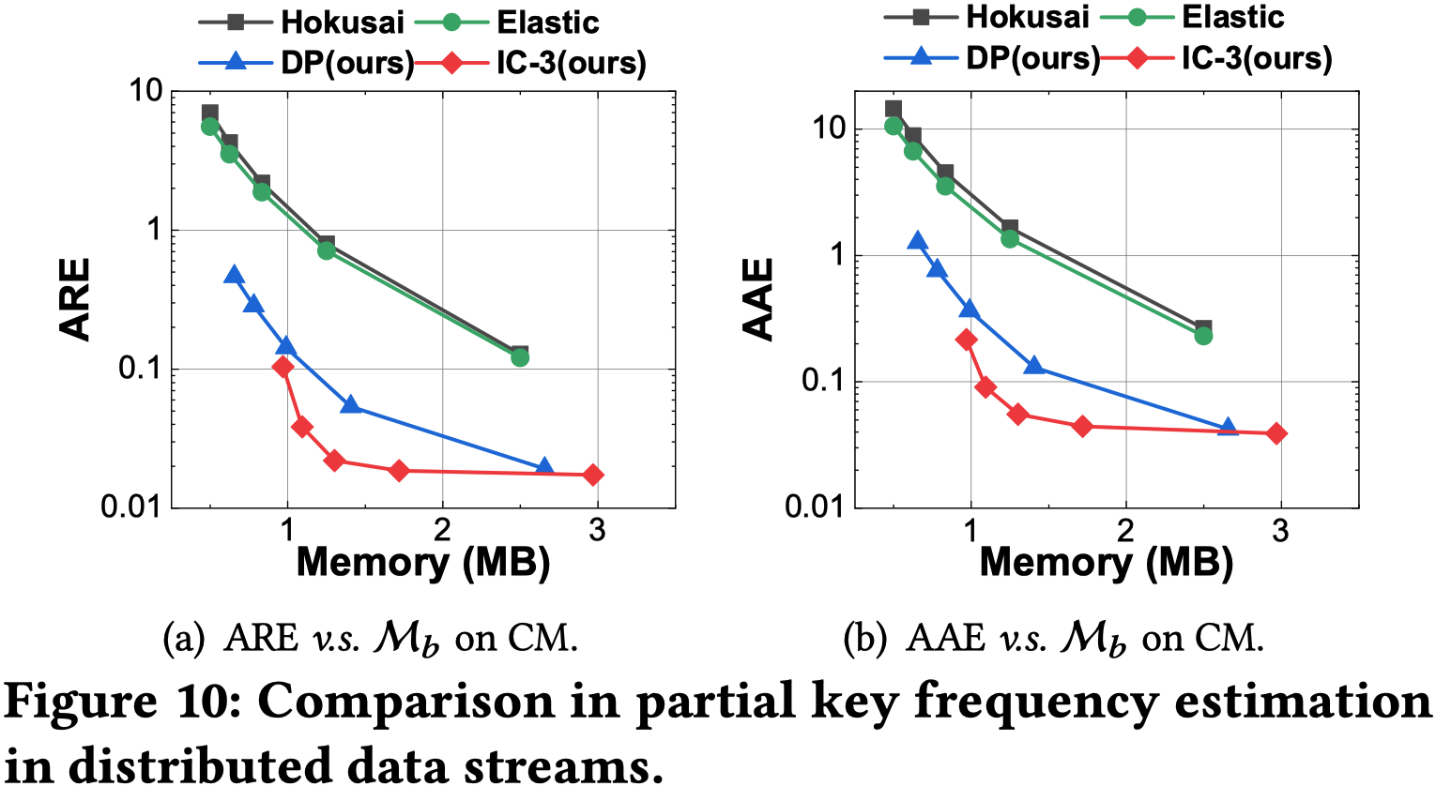
Experiments on Distributed Data Streams
Notes:
The second part is about distributed data streams. The experimental results show that our Cluster-Reduce is one or two orders of magnitude more accurate than the existing algorithms on different tasks and different sketches.

Slide 31
Experiments on Distributed ML
Notes:
The third part is about distributed machine learning. Based on the framework of SketchML, we use Cluster-Reduce to further compress the MinMaxSketch which is used to approximately record the model gradients. The experimental results shown that compared with the original SketchML, the performance of SketchML using Cluster-Reduce is closer to transmitting exact gradients.

Slide 32
04
Part Four
Summary

Slide 33
Conclusion
Efficiency: Cluster-Reduce can compress a 160MB sketch within 1 second, using a single thread running on a 4.2GHz CPU.
Direct Query: the compressed sketch can be directly queried, with a throughput of 14.7M queries per second.
Accuracy: the compressed sketch can achieve up to 60 times smaller error than the prior works.
E-mail: zyk@pku.edu.cn
Notes:
In summary, we propose Cluster-Reduce, a generic framework for compressing sketches, which meets all three requirements of designing a sketch compression algorithm.
Thank you for watching. If you have any questions about our paper, please contact me by email.

